Slide 1
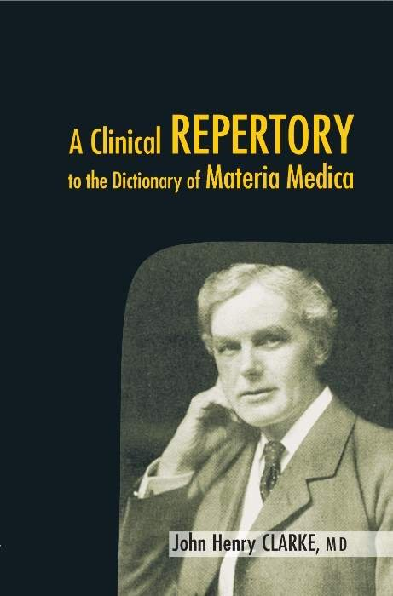
A CLINICAL REPERTORY TO THE DICTIONARY OF MATERIA MEDICA
Dr. S.P. SUJA, M.D (Hom)
Asst. Professor, Department of Repertory
Sarada Krishna Homoeopathic Medical College
Kulasekharam

Slide 2
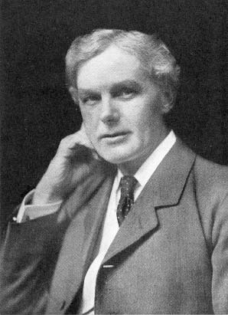
AUTHOR –
JOHN HENRY CLARKE

Slide 3
ABOUT THE REPERTORY
YEAR OF PUBLICATION -1904
NO : OF REMEDIES -1063
GRADATION - SINGLE GRADE
BASED ON - CLARKE DICTIONARY OF PRATICAL MATERIA MEDICA.

Slide 4
CONTENTS- (5 SECTIONS )
PART -1
Introduction to clinical repertory
Clinical repertory
PART -2
Note to repertory of causation
Repertory of causation
PART -3
Repertory of temperaments,dispositions , constitutions & states.

Slide 5
PART - 4
Prefatory note to clinical relationships
Repertory of clinical relationships
PART - 5
Introduction to repertory of natural relationships
Repertory of natural relationships.

Slide 6
REPERTORY OF NATURAL RELATIONSHIPS
ELEMENTS
A ) Alphabetical List
B ) List According To Atomic Wt
VEGETABLE KINGDOM
A )Alphabetical List
B )Systemic Arrangement
ANIMAL KINGDOM
A )Alphabetical List
B )Systemic Arrangement

Slide 7
SARCODES
NOSODES

Slide 8
CLINICAL REPERTORY
This section contains numerous clinical rubrics or nosological rubrics. The change in the fonts of the remedies in this section is not the gradation of remedies , instead source from which the remedies have taken .
Italics indicates remedies taken from prescriber

Slide 9
( Remedies in bracket ) indicates that it does not appear in clarke dictionary , but it has been added to the author’ s copy after the publication of the dictionary.

Slide 10
CONSTRUCTION
Alphabetical order
Rubrics are given in bold followed by a dot (.) & hyphen (-). The sub-rubrics mentioned after an indentation in CAPITAL ROMAN.
Cross reference are mentioned after the word “see also” in bold after the end of the rubric or subrubric.

Slide 11
Rubrics are given in location wise & the complaints of it are mentioned as subrubrics.
For eg :- Breast abscess of , cancer of , inflammation of, painful, tumour of it .
Diaphragm –affections of, rheumatism of spasms of etc.

Slide 12
MERITS
Plenty of diagnostic rubrics
For the study of Materia Medica.
Used as a bed side prescriber

Slide 13
REPERTORY OF CAUSATION
This section consist of different causations.
Based mainly on indexing & is done from various remedies under causation subsection from the dictionary of practical Materia Medica.

Slide 14
CONSTRUCTION OF THE REPERTORY
Alphabetical order
Rubrics are given in bold followed by a dot & a hyphen.
Subrubrics are mentioned after the word.
(See also in bold after the end of the rubric)
The remedies which are not found in the Dictionary of practical Materia Medica are given in bracket.

Slide 15
In some rubrics the (=) sign is used with some condition & a remedy in brackets This indicates the cause for that condition mentioned in brackets. The remedies are given either inside the bracket or outside.
Eg :- sleep loss of.- ( = agalactia , causticum)
This means that loss of sleep causes agalactia.

Slide 16
MERITS
Useful section as the homoeopathic point of view, the most imp point for the prescription.
This section can be considered as aggravation.

Slide 17
REPERTORY OF TEMPERAMENTS , DISPOSITION, CONSTITUTION & STATES
Alphabetical

Slide 18
CONSTRUCTION OF REPERTORY
DEPENDING UPON AGE
Adults
Aged person
Babies
Bachelor
Boys
Elderly persons
Girls or women
Infants
Males ,Men
Widow
Young

Slide 19
DEPENDING ON CONDITION
Gouty
Haemorrhoidal
Asthmatics ,old

Slide 20
DEPENDING ON CONSTITUTION
Carbo –nitrogenoid
Bilious
Hydrogenoid
Nervous
Scrofulous
Venous

Slide 21
DEPENDING ON DIATHESIS
ARTHRITIC
GOUTY
PSORIC

Slide 22
DEPENDING ON DISPOSITION
GENTLE
IRRITABLE
MALICIOUS
MILD
SAD
YIELDING

Slide 23
DEPENDING ON TEMPERAMENT
SANGUINE
BILIOUS
LYMPHATIC
HASTY
LEUCO - PHLEGMATIC
MELANCHOLIC
NERVOUS

Slide 24
CLINICAL RELATIONSHIPS (TABULAR FORM )
COMPLEMENTARY
REMEDIES FOLLOWS WELL
REMEDY IS FOLLOWED WELL BY
COMPATIBLE REMEDIES
INCOMPATIBLE REMEDIES
REMEDY ANTIDOTES
REMEDY IS ANTIDOTED BY
DURATION OF ACTION OF REMEDIES

Slide 25
REPERTORY OF NATURAL RELATIONSHIPS
CONSTRUCTION
METALS & ELEMENTS
VEGETABLE KINGDOM
ANIMAL KINGDOM
SARCODES
NOSODES

Slide 26
METALS OR ELEMENTS
Here an alphabetical list of elements is given with its symbol & atomic wt following element & an index no: prefix to it Eg:-10 Alum 27.10 etc
The second list is followed in order of its atomic wt where G & Roman numerical means the group in which the particular elements belongs Eg:-G .I Hydrogenium 1.008
The third list –MENDELEFFIAN GROUP
Eg:-Group 1-Lithium , Natrum ,Kali etc

Slide 27
VEGETABLE KINGDOM
Alphabetical list of natural botanical orders represented in the Materia Medica.
The Number affixed to each natural order shows the place of order in the systematic arrangement given in the succeeding section.

Slide 28
ANIMAL KINGDOM
Alphabetical list of natural orders

Slide 29
SARCODES
List of remedies made from preparations of healthy tissues & secretions .
Preparations of poisonous animals are not included.
25 sarcodes - healthy tissues & secretions & supplementary list of 12 remedies derived or altered tissues & secretions as urea, uric acid from.

Slide 30
NOSODES
Nosodes are remedies derived from the morbid tissues & secretions containing specific virus of diseases.
It consists of 18 animal source remedies & 4 vegetable source remedies.

Slide 31
THANK YOU

